Slide 2
John 17:23
“I in them and You in Me, that they may be perfected in unity, so that the world may know that You sent Me, and loved them, even as You have loved Me.”

Slide 3
Colossians 3:14
“Beyond all these things put on love, which is the perfect bond of unity.”

Slide 4
Ephesians 4:13
“until we all attain to the unity of the faith, and of the knowledge of the Son of God, to a mature man, to the measure of the stature which belongs to the fullness of Christ”

Slide 5
Ephesians 4:3
“ being diligent to preserve the unity of the Spirit in the bond of peace”

Slide 6
THERE’S ONLY
ONE!
Ephesians 4:4-6

Slide 7
Ephesians 4:4-6
BODY
Organization
Refers to Church
Eph. 1:2-23
Col. 1:18
Many Members in ONE Body
Eph. 2:14-16
1 Cor. 12:12-14
Rom. 12:5
ONE

Slide 8
Ephesians 4:4-6
BODY
Organization
One Spirit guided the Apostles
No other way to know God’s mind
2 Pet. 1:3 nothing was left out
ONE
SPIRIT
Revelation
Anything true is not new; anything new is not true!

Slide 9
Ephesians 4:4-6
BODY
Organization
All Believers Hope For Heaven
2 Corinthians 4:16-18
ONE
HOPE
Desire
SPIRIT
Revelation

Slide 10
Ephesians 4:4-6
BODY
Organization
Christ Is Lord. He Has All Authority.
Eph. 1:22
Matt. 28:28
Heb. 1:2
Acts 3:22
Authority For All Religious Practices Must Come From Christ.
ONE
HOPE
Desire
SPIRIT
Revelation
LORD
Authority

Slide 11
Ephesians 4:4-6
BODY
Organization
Romans 10:17
Jude 3 “the faith”
2 Corinthians 5:7
“Different Faiths”
Unity In Doctrine
FAITH
Doctrine
ONE
HOPE
Desire
SPIRIT
Revelation
LORD
Authority

Slide 12
Ephesians 4:4-6
BODY
Organization
BAPTISM
Practice
In Water
Acts 10:47-48
We “Put On Christ”
We Are Buried With Him
Essential To Unity
FAITH
Doctrine
ONE
HOPE
Desire
SPIRIT
Revelation
LORD
Authority

Slide 13
Ephesians 4:4-6
BODY
Organization
BAPTISM
Practice
FAITH
Doctrine
ONE
HOPE
Desire
SPIRIT
Revelation
GOD
Worship
LORD
Authority

Slide 14
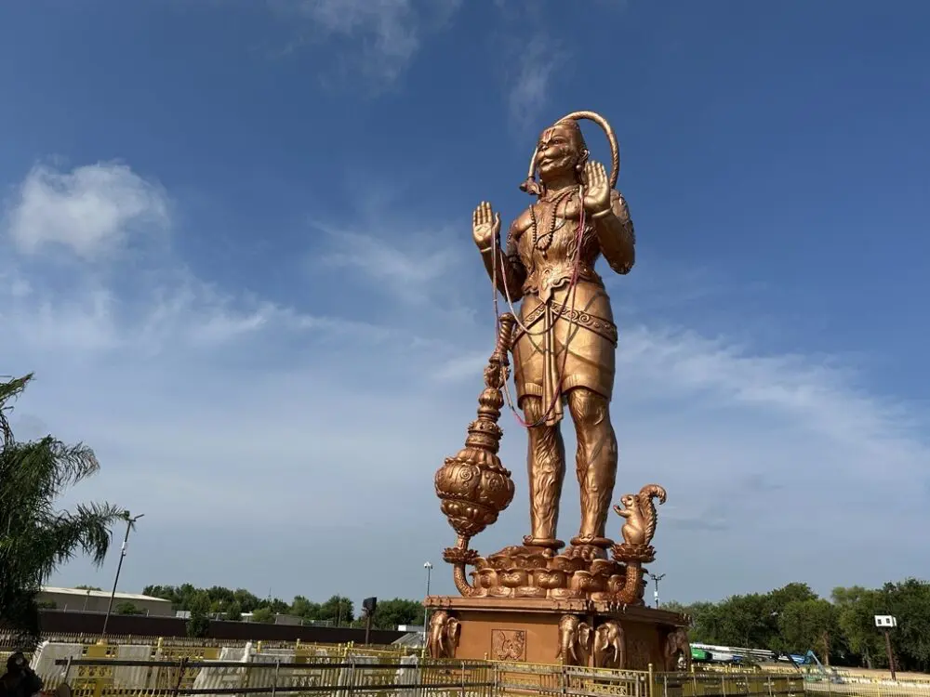

Slide 15
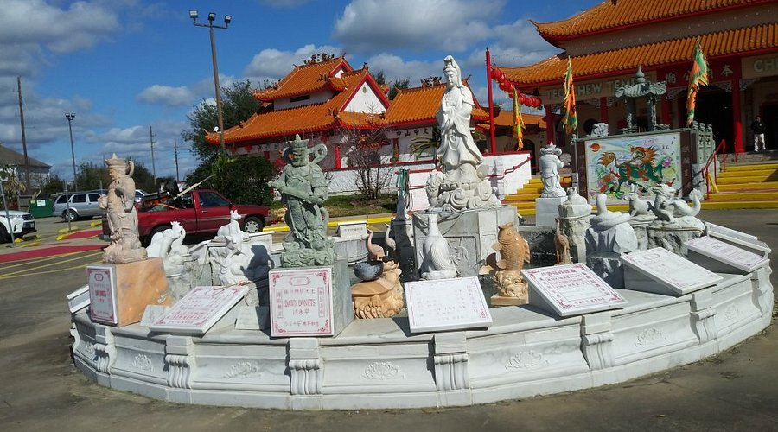
Teo Chew Temple in Houston

Slide 16
Ephesians 4:4-6
BODY
Organization
BAPTISM
Practice
We Must Worship The ONE True God.
1 Cor. 8:6
1 John 5:20
John 4:24
According To His Directions
FAITH
Doctrine
ONE
HOPE
Desire
SPIRIT
Revelation
GOD
Worship
LORD
Authority

Slide 17
Ephesians 4:4-6
BODY
Organization
BAPTISM
Practice
“ONE” Is Very Important!
These 7 Truths Enable Unity With God!
Have You Obeyed God’s ONE Way Of Salvation?
FAITH
Doctrine
HOPE
Desire
ONE
SPIRIT
Revelation
GOD
Worship
LORD
Authority

