Slide 2
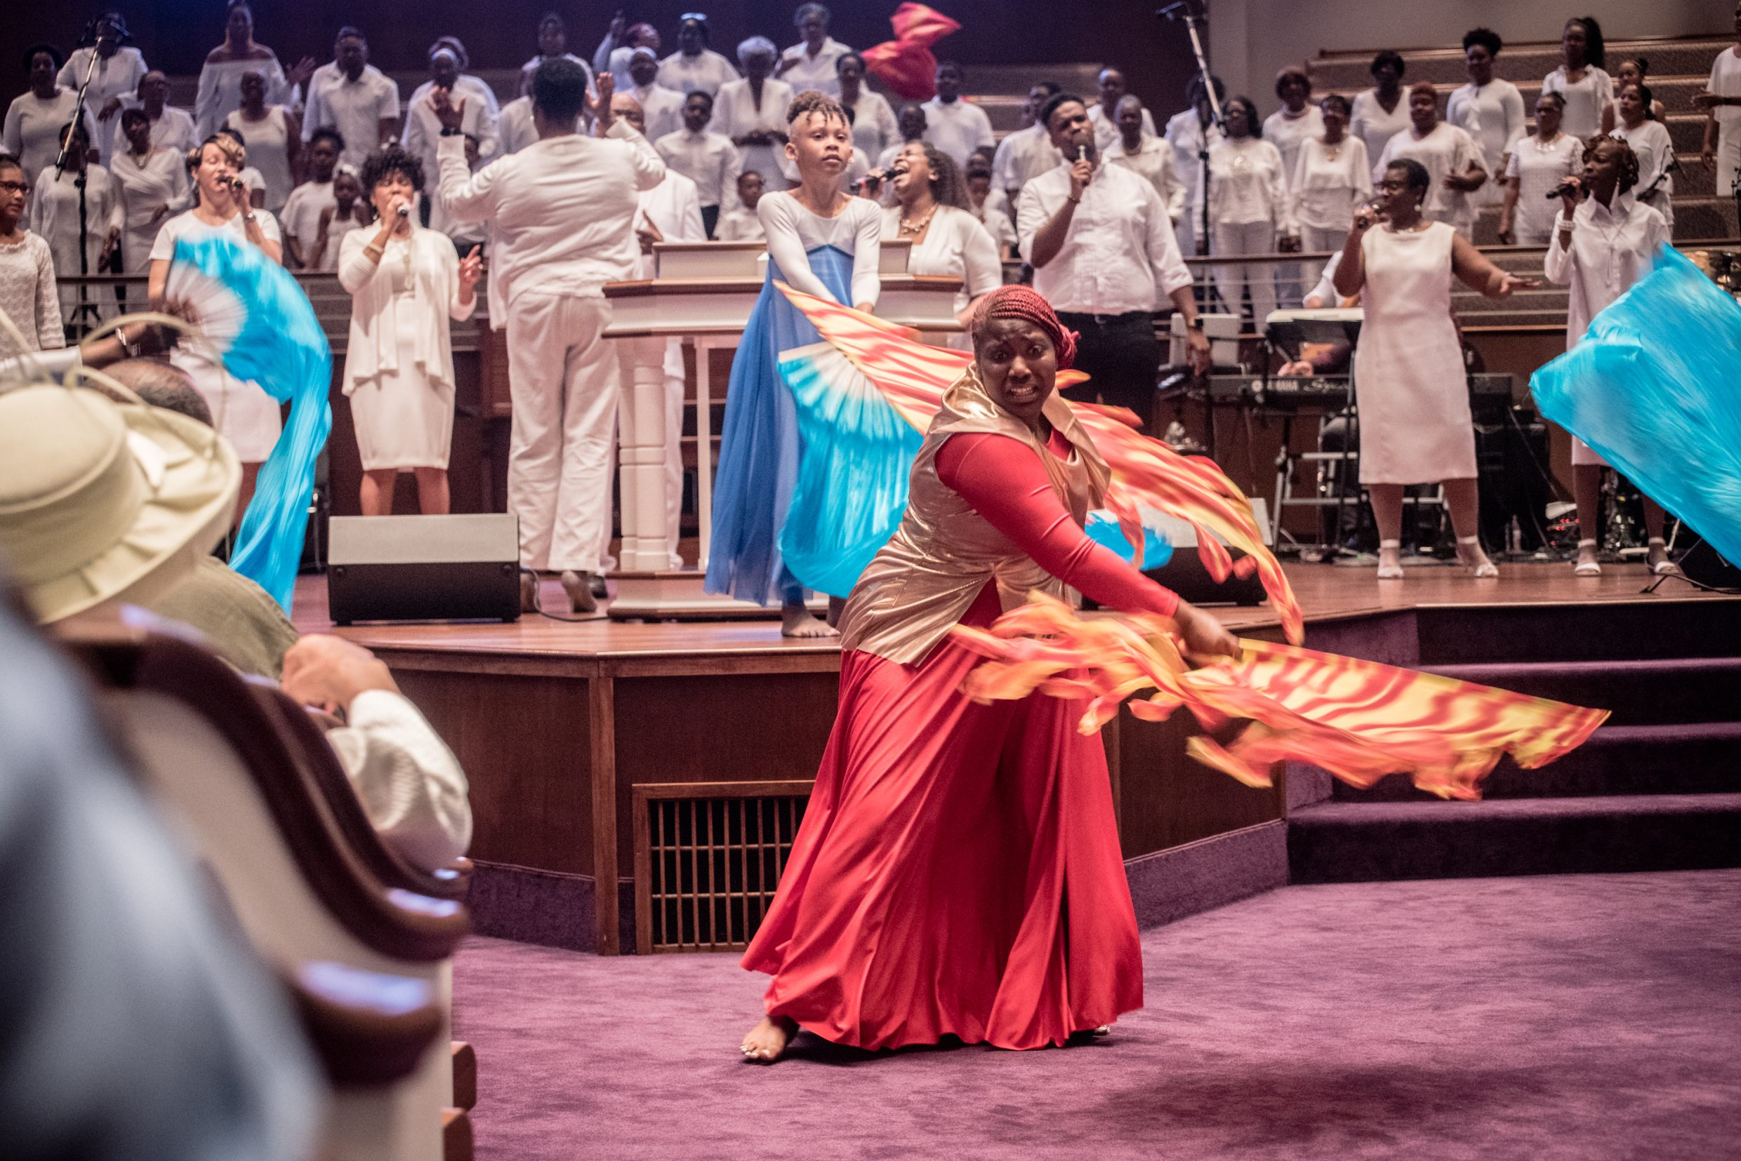

Slide 10
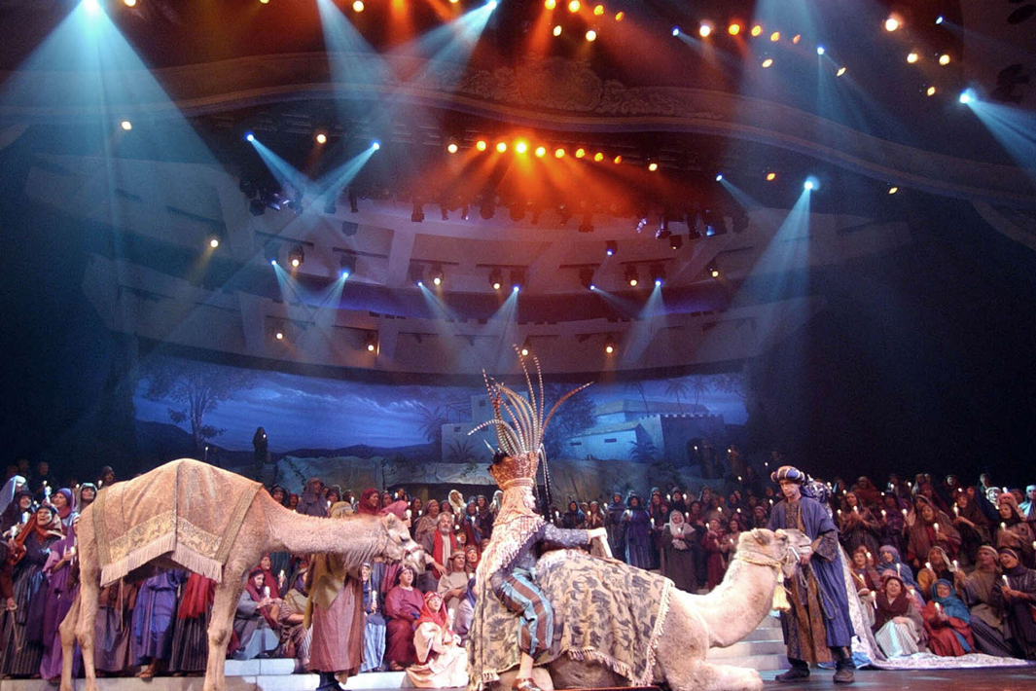

Slide 13
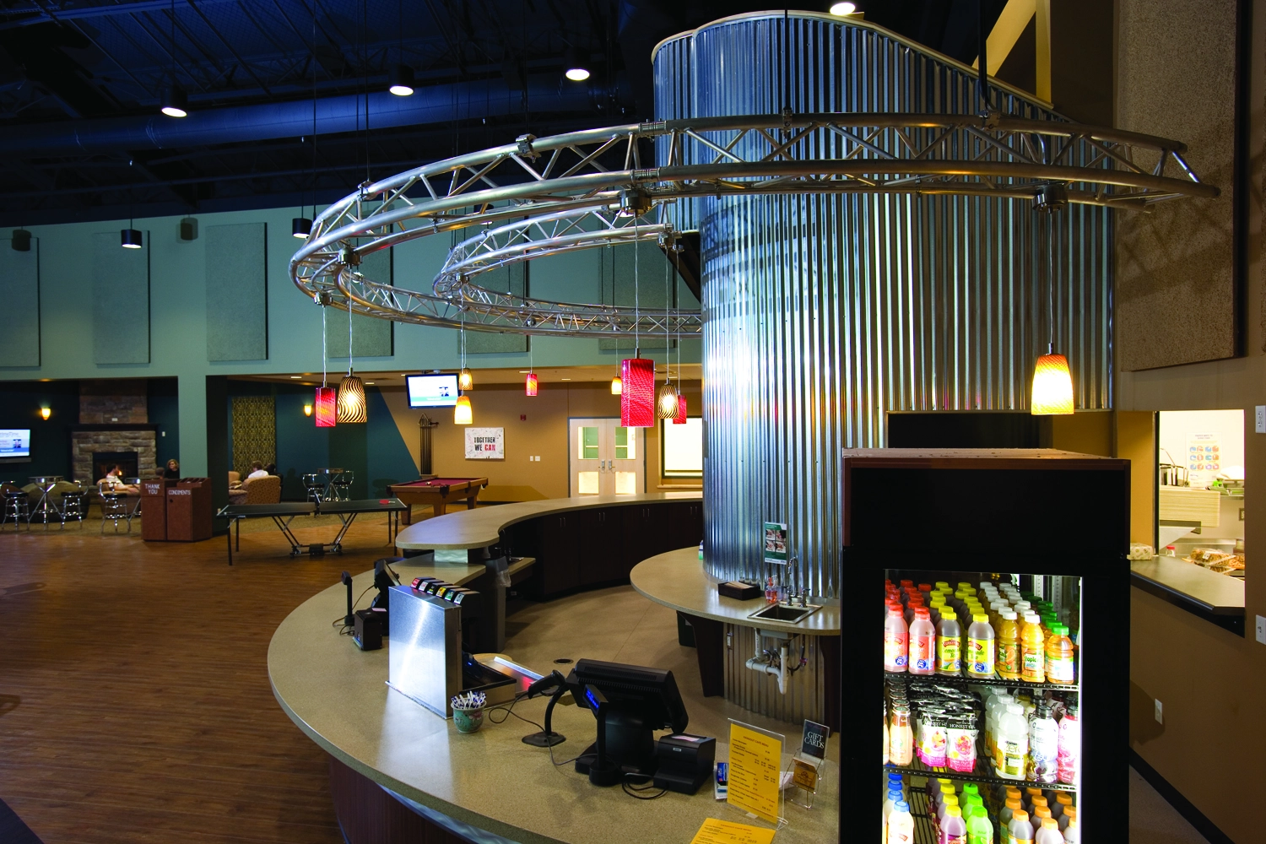

Slide 14
Lakewood Church Bookstore

Slide 18
What It Is…
THE CHURCH
What It Is & What It Is For
The Called Out
How are we called?
“It was for this He called you through our gospel, that you may gain the glory of our Lord Jesus Christ.” (2 Thessalonians 2:14)
“to open their eyes so that they may turn from darkness to light…” (Acts 26:18)
God “rescued us from the domain of darkness, and transferred us to the kingdom of His beloved Son” (Colossians 1:13)

Slide 19
What It Is…
THE CHURCH
What It Is & What It Is For
The Called Out
The Saved
“the Lord was adding to their number day by day those who were being saved” (Acts 2:47)
“For all of you who were baptized into Christ have clothed yourselves with Christ” (Galatians 3:27)
We can “obtain the salvation which is in Christ” (2 Timothy 2:10)
“For by one Spirit we were all baptized into one body…” (1 Corinthians 12:13)
[Ephesians 1:22-23]

Slide 20
What It Is…
THE CHURCH
What It Is & What It Is For
The Called Out
The Saved
The Sanctified
“To the church of God which is at Corinth, to those who have been sanctified in Christ Jesus, saints by calling…” (1 Corinthians 1:2)
“such were some of you; but you were washed, but you were sanctified, but you were justified …” (1 Corinthians 6:11)
“…as Christ also loved the church and gave Himself up for her so that He might sanctify her, having cleansed her by the washing of water with the word… (Ephesians 5:5:25-27)

Slide 21
What It Is…
THE CHURCH
What It Is & What It Is For
The Called Out
The Saved
The Sanctified
Depictions
The Church of God (1 Corinthians 1:2)
We are to live different from the world.
John 15:18-19; Romans 12:2; James 4:4; Philippians 2:15-16
The House Of God (1 Timothy 3:15; Ephesians 2:19)

Slide 22
What It Is…
THE CHURCH
What It Is & What It Is For
The Called Out
The Saved
The Sanctified
Depictions
The Temple of God (1 Corinthians 3:16-17)
“Do you not know that you are a temple of God and that the Spirit of God dwells in you?...”
Ephesians 2:19-22
The Kingdom Of God (Romans 14:17)
Elders (qualifications: 1 Timothy 3, Titus 1)
Deacons (qualifications: 1 Timothy 3)

Slide 23
What It Is…
THE CHURCH
What It Is & What It Is For
The Called Out
The Saved
The Sanctified
Depictions
Two Uses
Universal Sense
Local Sense (1 Cor. 1:2; Eph. 1:1; Col. 1:2)
“they went down to Antioch; and having gathered the congregation together…” (Acts 15:30-31)

Slide 24
What It Is For…
THE CHURCH
What It Is & What It Is For
What it is NOT
NOT a political entity
“render unto Caesar the things that are Caesar’s, and to God the things that are God’s.” (Matthew 22:21)

Slide 25
What It Is For…
THE CHURCH
What It Is & What It Is For
What it is NOT
NOT a political entity
NOT to entertain
NOT to offset expenses of human institutions
Whatever the individual can do, the church can do. FALSE

Slide 26
What It Is For…
THE CHURCH
What It Is & What It Is For
What it is NOT
What it is for…
Evangelism
“Go therefore and make disciples of all the nations, baptizing them…” (Matthew 28:19-20)
“Go into all the world and preach the gospel to all creation…” (Mark 16:15-16)
The church is “the pillar and support of the truth” (1 Timothy 3:15)

Slide 27
What It Is For…
THE CHURCH
What It Is & What It Is For
What it is NOT
What it is for…
Evangelism
Edification
“therefore encourage one another and build up one another…” (1 Thessalonians 5:11)
“grow in the grace and knowledge of our Lord and Savior Jesus Christ” (2 Peter 3:18)
“give attention to the public reading of Scripture, to exhortation and teaching” (1 Timothy 4:3)

Slide 28
What It Is For…
THE CHURCH
What It Is & What It Is For
What it is NOT
What it is for…
Evangelism
Edification
Benevolence
Individual Instructions To All People
“…go and do the same…” (Luke 10:30-37)
“He who steals must steal no longer; but rather he must labor, performing with his own hands what is good, so that he will have something to share with one who has need.” (Ephesians 4:28)
“…first learn to practice piety in regard to their own family and to make some return to their parents…” (1 Timothy 5:4)

Slide 29
What It Is For…
THE CHURCH
What It Is & What It Is For
What it is NOT
What it is for…
Evangelism
Edification
Benevolence
Individual Benevolence To All People
The Church’s Contributions Are More Limited
“For Macedonia and Achaia have been pleased to make a contribution for the poor among the saints in Jerusalem” (Romans 15:26)
“Concerning the collection for the saints...” (1 Corinthians 16:1-2)

Slide 30
THE CHURCH
What It Is & What It Is For
The Called Out
The Saved
The Sanctified
The Baptized
Into Christ
Universal
Local
For Evangelism
For Edification
For Benevolence

