Slide 2
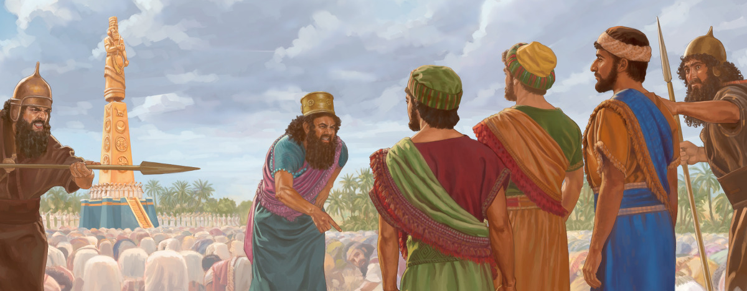
Stand Up For God
Daniel 3:16-30

Slide 3
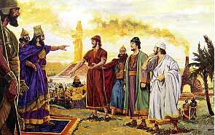
Bow Or Burn
Why did they disobey their government and King?
Our stand against abortion
Our continued stance against homosexuality
Standing for God’s definition of marriage
Standing Against the Rise of Islam in America
A lot is at stake

Slide 4
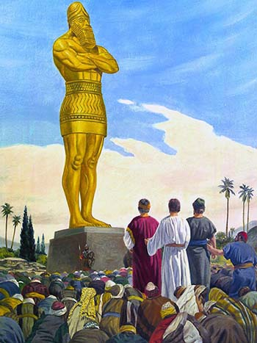
Resist Compromise!
We won’t be worshipping in our hearts… (Heb.10:26-27)
The ends don’t justify the means!
Everybody else is doing it! This is not a good time… (Heb. 13:5)

Slide 5
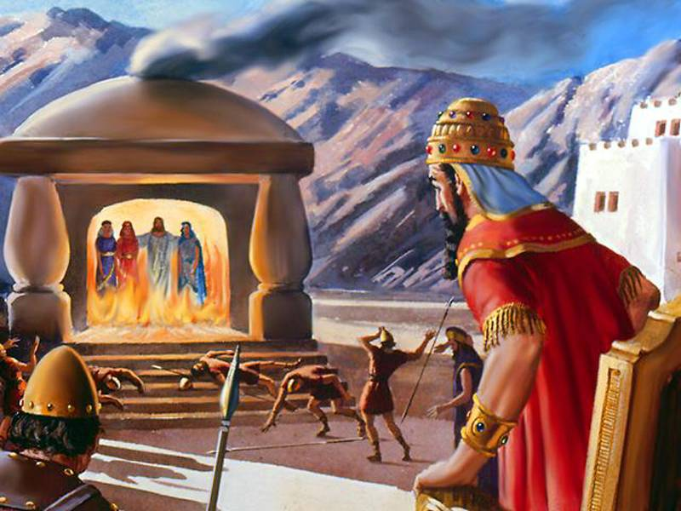
Didn’t know if God would deliver (3:17-18)
God does not always deliver from persecution (Heb. 11:36-38; Matt. 5:11-12; 1 Thess. 3:3-4)
Faith looks beyond present (2 Cor. 4:16-18)
We must also stand firm! (Eph. 6:11-13; 2 Thess. 2:15; 1 Cor. 16:13)
Stand Firm!

Slide 6
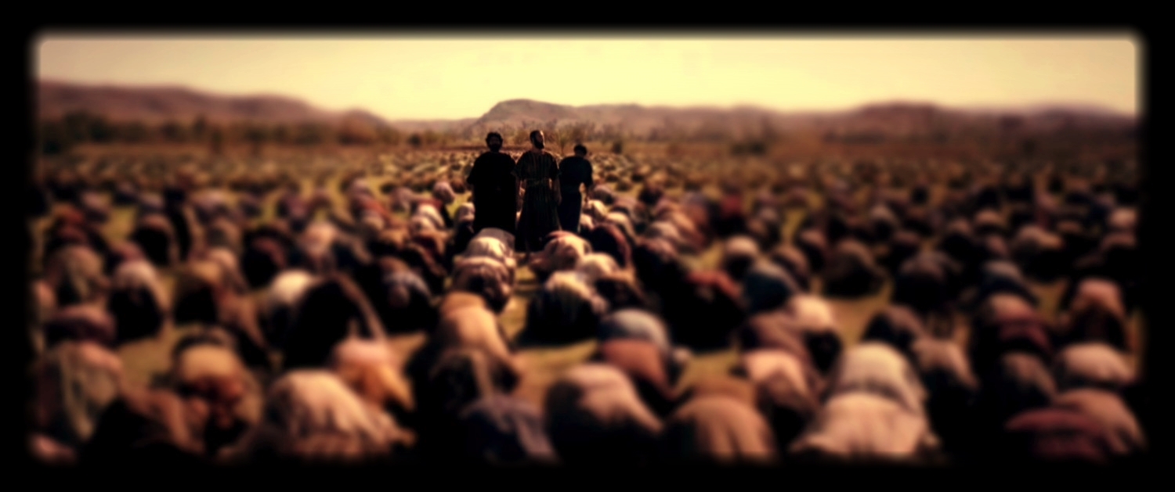
Do you trust God?
Are you standing for Him?
Complete Trust!

