Slide 2
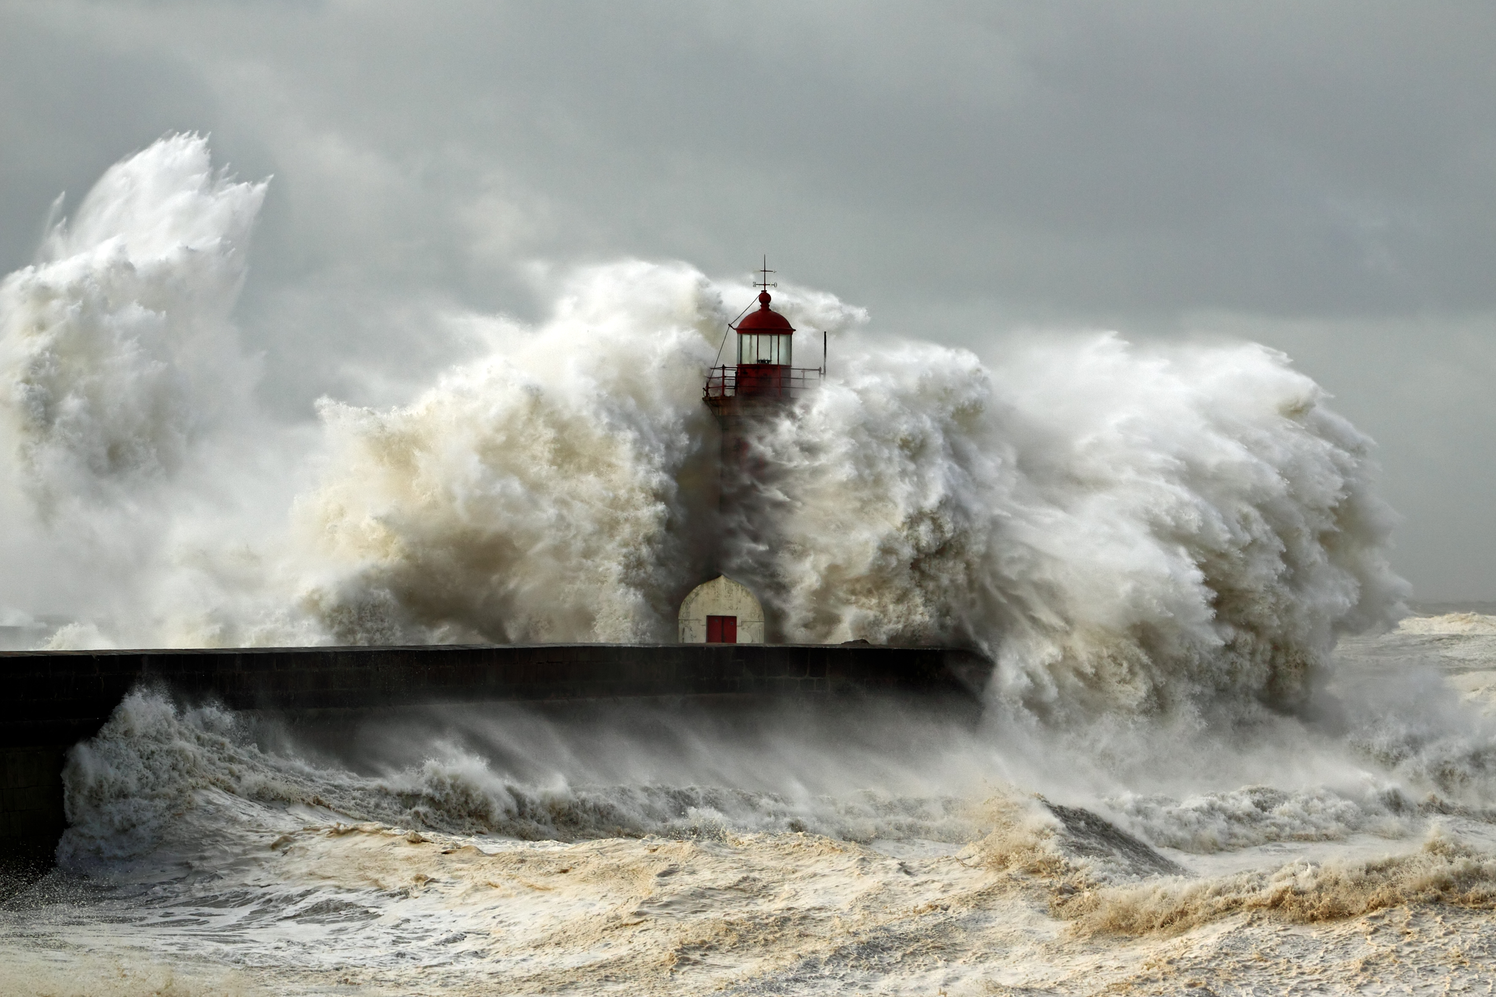
BUILD ON
THE ROCK

Slide 3
Judging (Matthew 7:1-6)
In the way you judge, you will be judged
Not all judgments are being condemned, for we are taught to make judgments. (1 Corinthians 5; 1 John 4:1; John 7:24; 1 Thessalonians 5:14)
BUILD ON THE ROCK

Slide 4
Judging (Matthew 7:1-6)
The speck and the log
I need to be careful about my own sin. (Col. 3:8; 1 Pet. 1:22; Gal. 6:1)
Don’t be a hypocrite (7:5)
Dogs and Swine (7:6)
BUILD ON THE ROCK

Slide 5
Ask, Seek, Knock (Matthew 7:7-12)
The importance of prayer (Matt. 6:14-15; James 1:6-7; James 4:3; 1 John 4:14; Luke 11:5-10)
A comparison of parents to God (Matt. 7:9)
Matt. 7:11 “if you then, being evil”
“How much more will your Father who is in heaven give what is good to those who ask Him!”
Romans 5:8-10; 15
BUILD ON THE ROCK

Slide 6
The Golden Rule (Matthew 7:12)
Jesus lived this principle on earth.
“For this is the Law and the Prophets” (Matt. 22:36-40)
BUILD ON THE ROCK

Slide 7
CONCLUSION
Do we hear the words of Christ in Matthew 7?
Are we acting on these words?
Are we building on the rock?
BUILD ON THE ROCK

