Slide 2
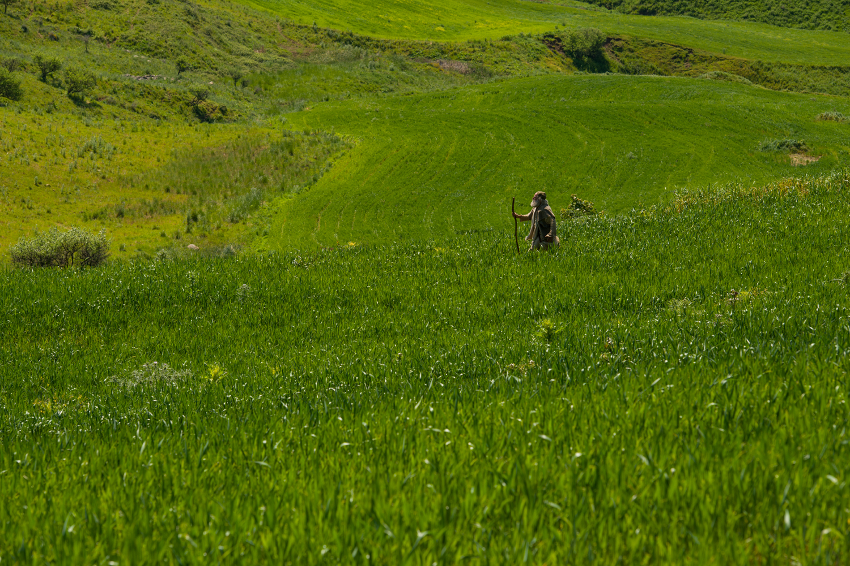
Parable Of The Lost Sheep
Luke 15:3-7

Slide 3
We Can Be Lost
We can be separated from the group
Some do not look up
Some wander off
Some purposefully leave to become lost (1 Pet. 2:25; 2 Pet. 2:15)
They don’t know how to return (Acts 26:18; 2 Cor. 4:3-4)
They believe they won’t be accepted back (Luke 17:3-4; Eph. 4:32; Matt. 26:22; 1 John 1:8-9; James 5:19-20)

Slide 4
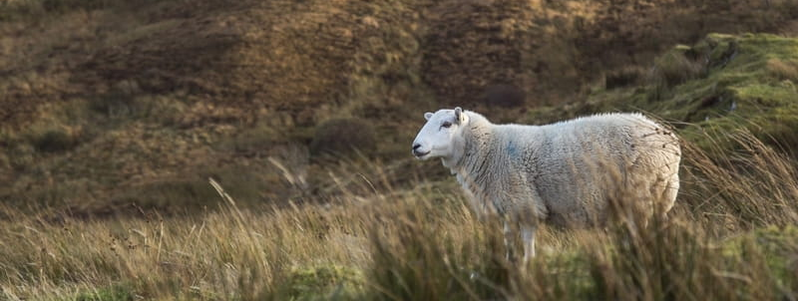
The Foolishness Of Wanderer
LEAVES THE SECURITY OF THE FOLD (2 Thess. 3:3; 1 Pet. 1:5; 4:19)
WANDERER IS IN DIRE STRAITS (John 15:5)

Slide 5
See Christ’s Love For the Lost
JESUS KNOWS WHEN WE STRAY (John 10:14; 2 Pet. 3:9)
MORE CONCERNED FOR LOST THAN 99 FAITHFUL (Matt. 9:12; Luke 19:10)
JESUS SEEKS US OUT THAT WE MIGHT BE SAVED (John 10:11, 15-18)
HE CONTINUALLY LOOKS FOR THE LOST ONE

Slide 6
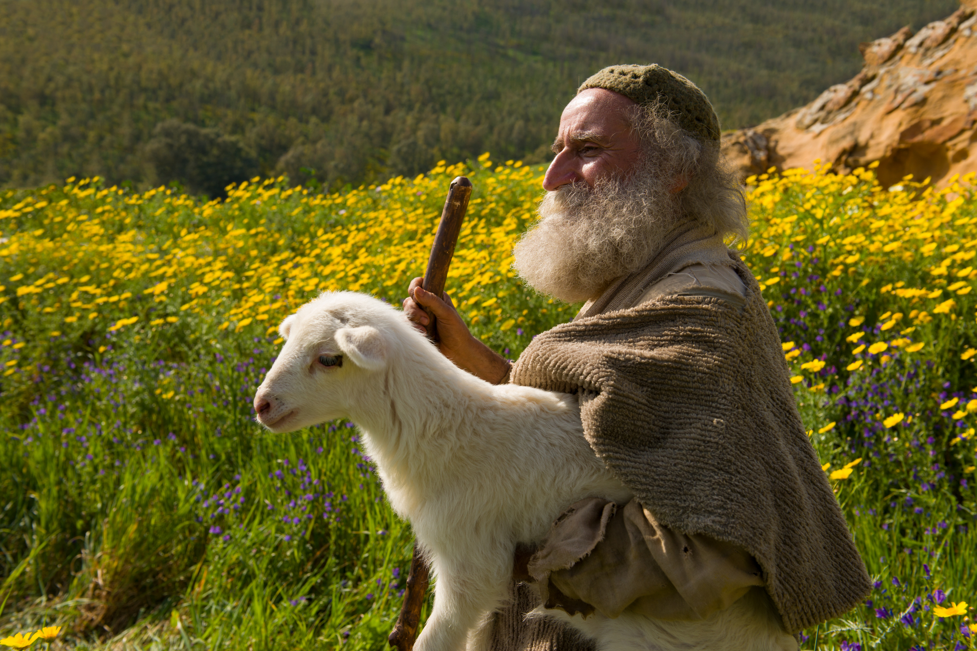
The Relief & Joy Of Finding The Lost
BEING RESCUED
THE JOY OF CHRIST (Luke 15:5)
THE REJOICING IN HEAVEN (Luke 15:10)
RECOGNIZE THE IMPORTANCE GOD PLACES ON REPENTANCE

Slide 7
Conclusion
Christ is the good shepherd.
We’ve all been as sheep who have gone astray.
Be a part of God’s fold!

