Slide 2
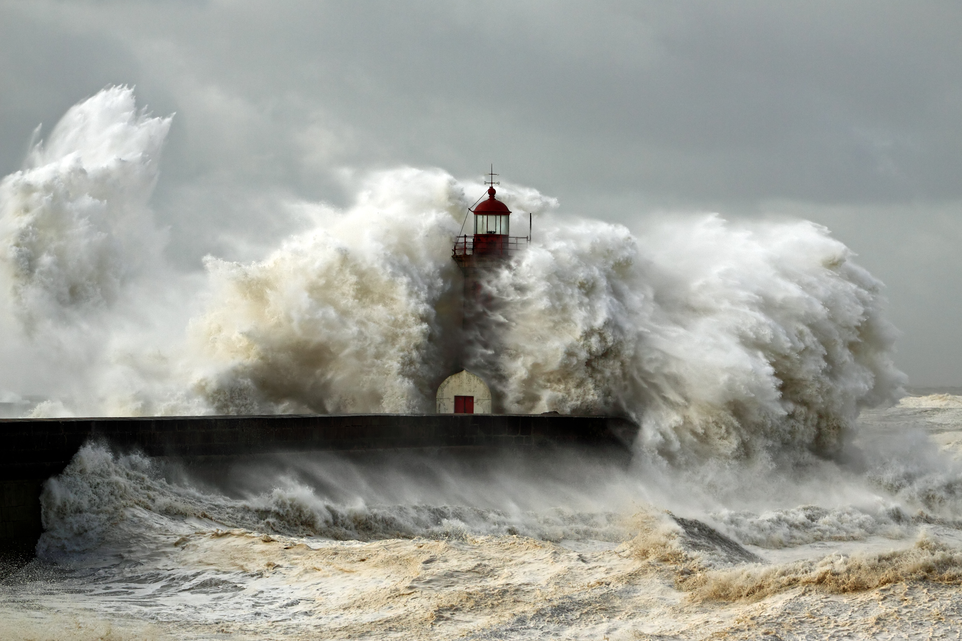
BUILD ON
THE ROCK

Slide 3
Prioritize What We Treasure (Matthew 6:19ff)
6:19 – Not treasures on earth (1 Tim. 6:17-19; Luke 12:20-21; Eccl. 5:10)
6:20 – “Lay up for yourselves treasures in heaven”
6:21 – “Where your treasure is…there your heart will be also.”
BUILD ON THE ROCK

Slide 4
Serving Two Masters (Matthew 6:22-23)
Some have difficulty understanding the imagery.
Spiritual vision can be clouded by Materialism (Luke 12:15; Eccl. 5:10)
No one can serve two masters (Luke 16:14; 1 John 2:15)
All good things are from God (1 Tim. 6:17; Acts 14:17; James 1:17)
BUILD ON THE ROCK

Slide 5
The Worries Of Life (Matthew 6:25-34)
The opposite of storing up treasures in heaven.
What are necessities?
God will provide! (Rom. 8:32)
Where our trust should be placed (Eph. 4:28; 2 Thess. 3:10; 1 Tim. 5:8)
Worry is pointless.
BUILD ON THE ROCK

Slide 6
Our Main Concern (Matthew 6:33)
Not about a Kingdom yet to be established (Col. 1:13; Heb. 12:28)
We must humble ourselves to the will of God.
THEN: all these things will be added to you.
BUILD ON THE ROCK

Slide 7
CONCLUSION
How are we seen by Christ?
Are you building on the rock?
BUILD ON THE ROCK

